Slide 1
Introduction to Biological Data Structures and C Programming
Martin D Brazeau
m.brazeau@imperial.ac.uk

Slide 2
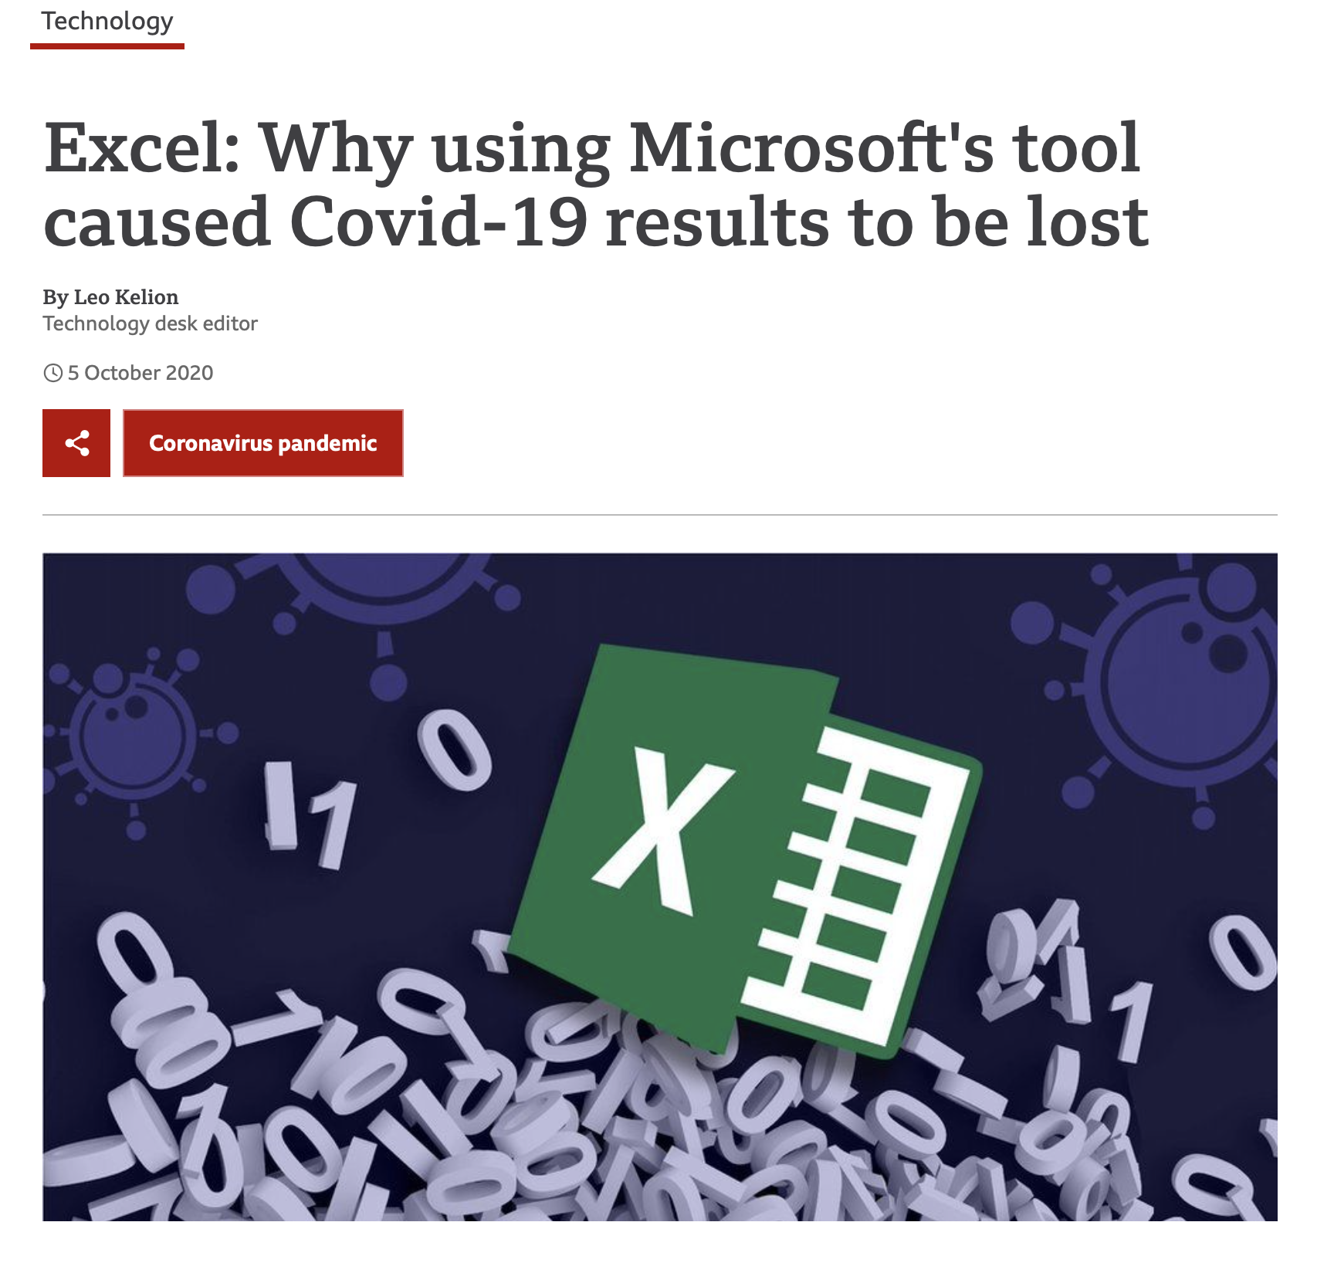
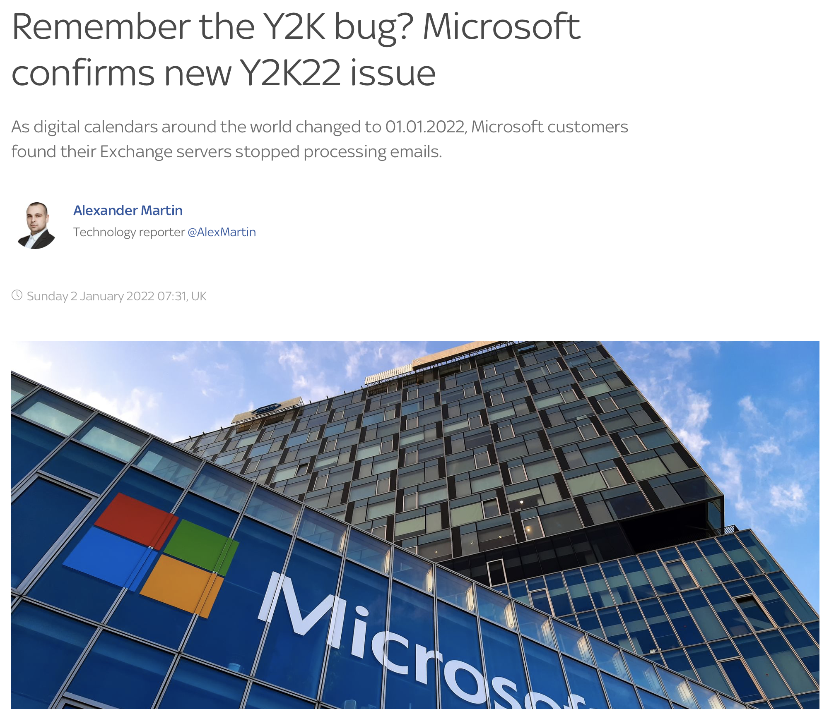
I read the news today, oh boy!
Notes:
While it’s unclear if these problems arose specifically because of the use of C or C-like languages, in this module (even, today, in fact) we are going to learn how knowledge of the C language would easily have alerted you to these problems.

Slide 3
Objectives
Learn basics of C (or C-style) programming
Understand ‘primitive’ data types
Learn how to write portable C code
Learn how low-level programming can speed up complex calculations
Learn to create (phylogenetic) networks in machine memory
Learn how to interact with these structures and perform calculations
Learn how to call C (or C++) from R

Slide 4
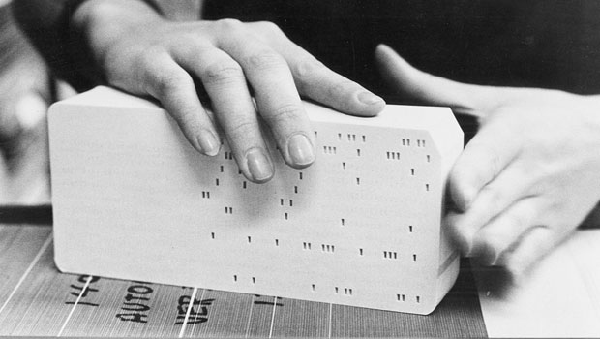
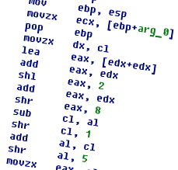
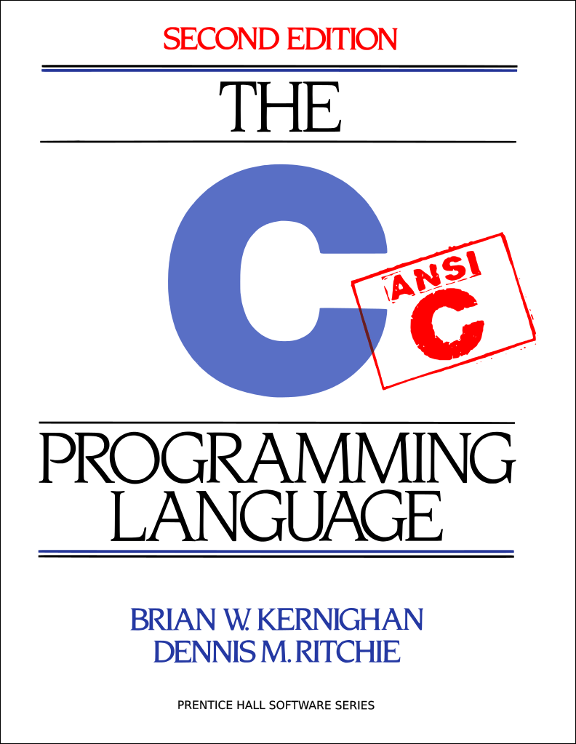
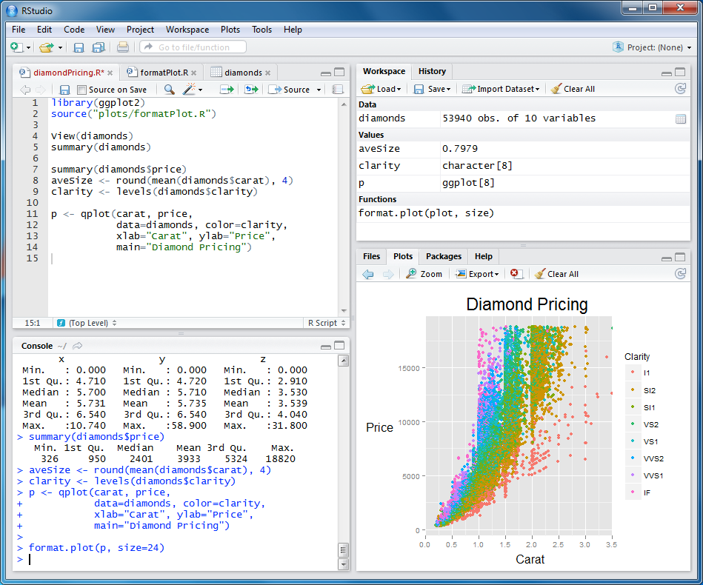
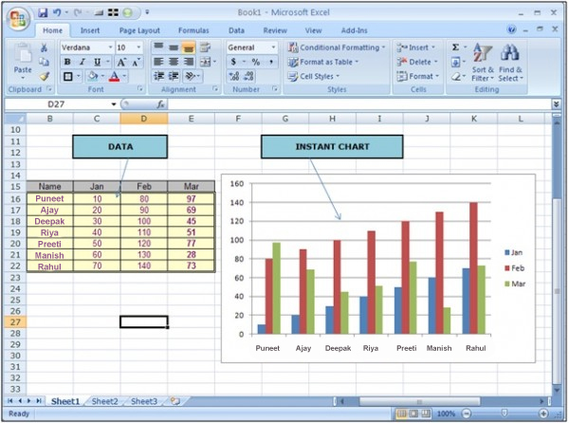


Lowest level
“for…”
“if-else”
“myVarName;”
You
Highest level
Notes:
C is considered one of the earliest high-level programming languages

Slide 5
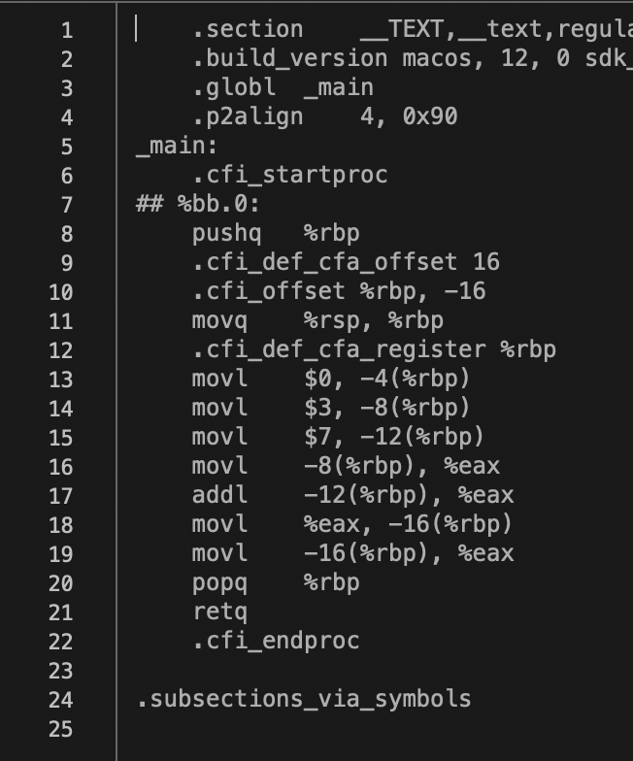
Assembly language
Writing out instruction sets.
Literally instructs the CPU what operations to perform on sets of bytes

Slide 6
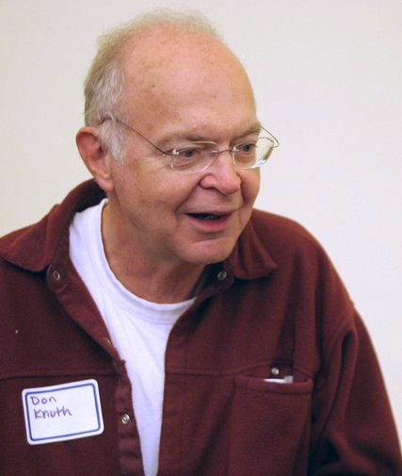
“Algebraic” programming languages
High-level languages that work like algebra:
Symbols & substitutions.
Expressions & evaluation.
Operations and precedence (BEDMAS or PEMDAS) apply.
Donald Knuth
Author: The Art of Computer Programming
Inventor of TeX

Slide 7
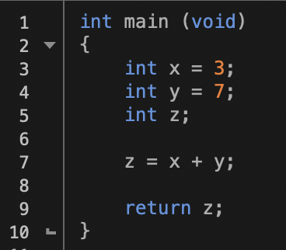
C vs Assembly
Notes:
In assembly, you are literally instructing the CPU in what to do in a step-by-step manner. You’re actually writing out the physical processes on the CPU registers that should take place.

Slide 8
C is a small language
auto | break | case | char
const | continue | default | do
double | else | enum | extern
float | for | goto | if
int | long | register | return
short | signed | sizeof | static
struct | switch | typedef | union
unsigned | void | volatile | while
Notes:
Here are the 32 keywords that constitute the core of the C language. That’s not a lot!
Of course, there are many symbols and operators; and a whole standard library adds many functions and macros, but even those libraries aren’t huge.

Slide 9
Why use C?
Practical:
Maybe you shouldn’t
You should probably use an object-oriented compiled language (e.g. C++, Objective-C, or C#)
C is a subset of C++ or Objective-C
C’s idioms are common in other C-like languages (C#, Java etc.)
Enough to get you going, and supplies basics of a compiled language
Notes:
You can write valid C code that will compile in C++ and Java.

Slide 10
Why use C?
Technical:
Speeds up calculations
Create standalone executables
Access to bit-level
Popular language, lots of support
Improve understanding of machine level and optimisation
Reading/using abundant C code in comp. biol.

Slide 11
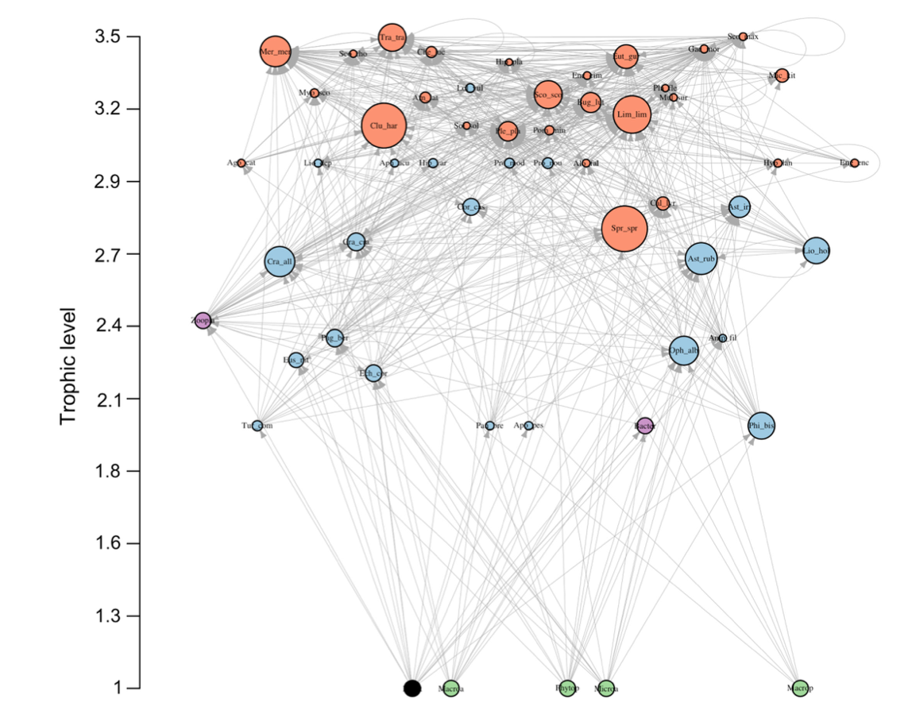
Data structures in biology
Many types of data structures: from simple vectors of data up to complex network topologies and more.
Olivier et al. 2019. Ecography

Slide 12
What is the connection between C and biological data structures?
None inherently
Data structures often imply computational intensity
Likely to need C more with large data structures and computationally hard problems than anywhere else

Slide 13
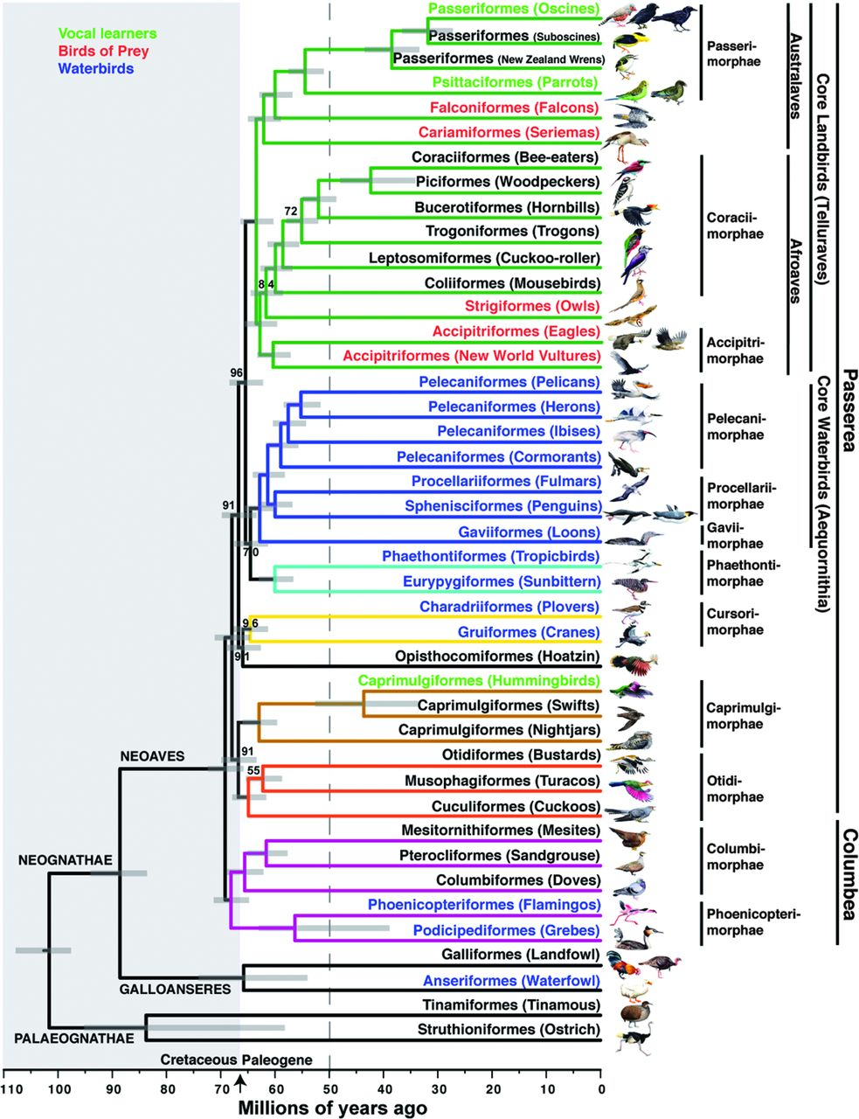
Phylogenetic trees: ‘roadmaps’ of evolution
Bird phylogeny derived from whole genome data
48 species representing major avian clades
Analyzed with maximum likelihood using RAxML (entirely written in C!)
Jarvis et al. 2014. Science

Slide 14
Phylogenetic analysis software written in C
Nearly all of them!
PAUP* (with some FORTRAN. Yes, FORTRAN(!!!!))
Phylip
TNT
RAxML
MrBayes
C++:
RevBayes
Java:
BEAST
Mesquite (sort of)

Slide 15
Things you can do with C
Pretty much anything (your own OS kernel!)
Computationally ’hard’ problems (i.e. big optimization problems).
Large numbers of floating-point calculations.
Rapid Boolean set analyses.
Network analyses.
Computationally demanding tasks with lots of loops, conditions etc.

Slide 16

The compiler
The compiler is really three programs:
#include …
{ … }
{ x = y… }
10011010 00010100
10010010 11110100
00101011 000010…
Preprocessor
Verify syntax
Paste in headers
Textual substitutions
Compiler
Transform source code into assembly
Perform optimzations
Translate to binary
Linker
Combines compilation units (i.e. files)
Generates:
Executable
Library

Slide 17
Basic C data types
Integral
int
char
_Bool
* (pointer to) <type>
Floating point
float
double
And, finally…
void

Slide 18
1. Ancestral states and optimising data on trees

Slide 19
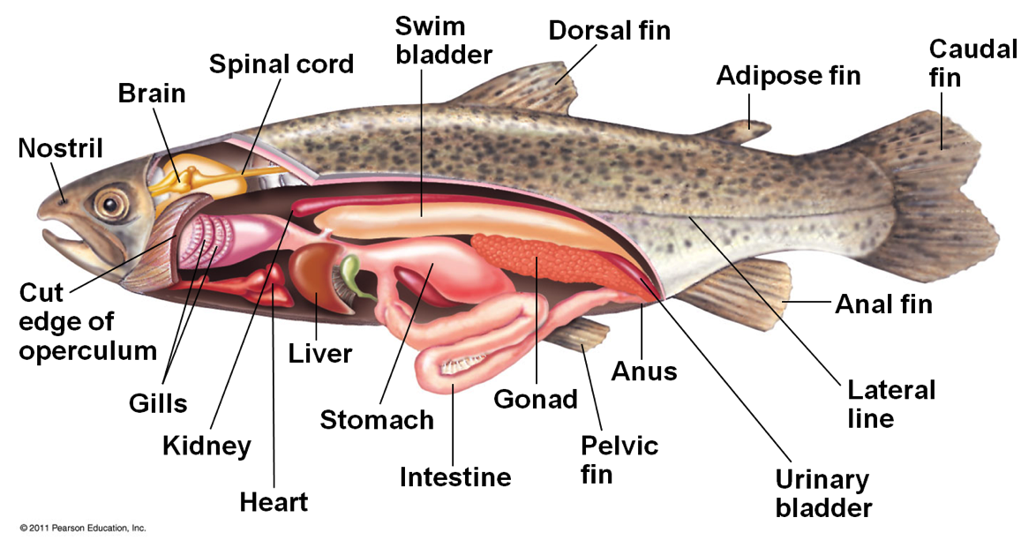
Which evolved first: the swim bladder or the lung?

Slide 20
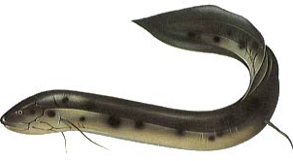
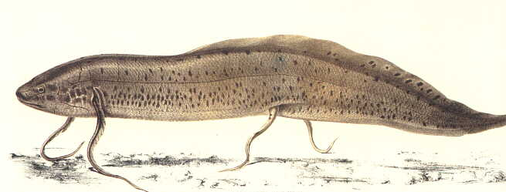
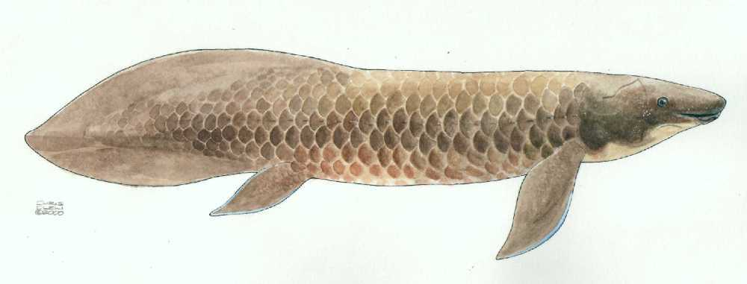
Lungfishes
Protopterus – 4 spp.
Africa
Lepidosiren paradoxa – from South America
Neoceratodus forsteri
Australia
Proper lobate fins
Notes:
The South American and African genera have little whip-like pectoral fins.

Slide 21
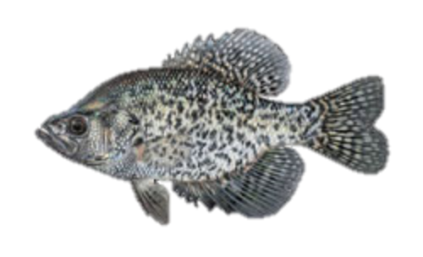
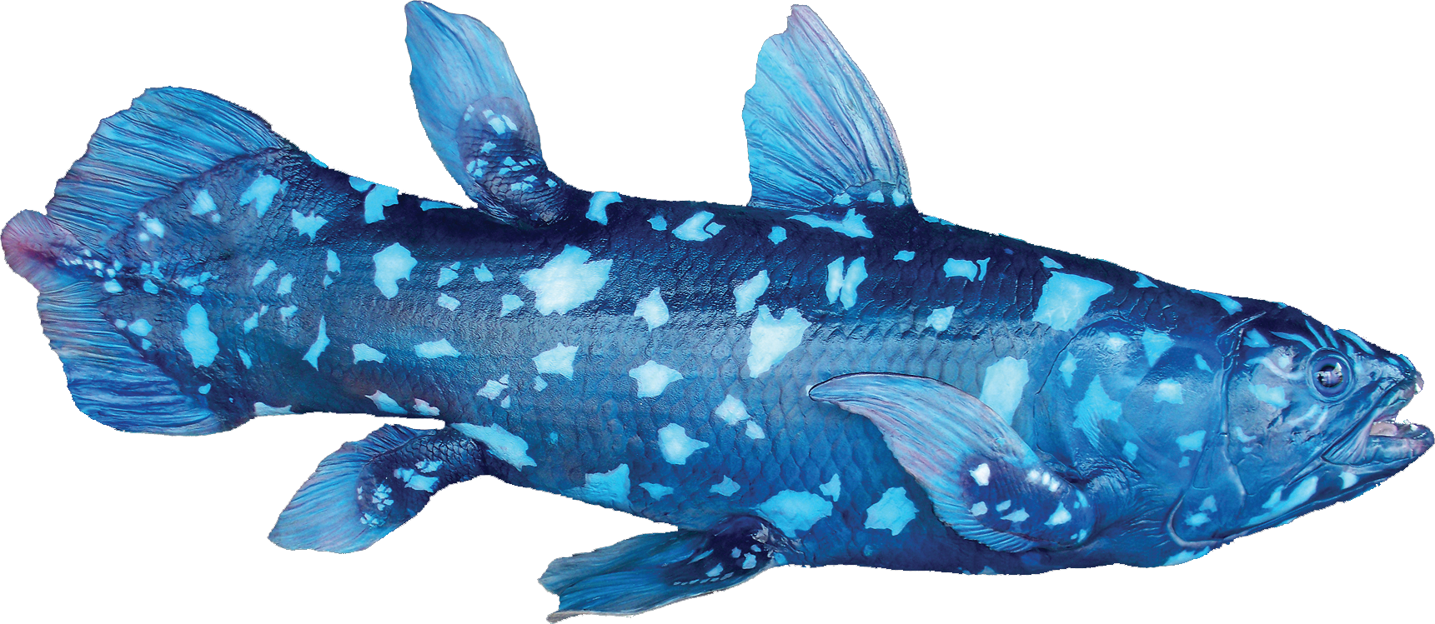
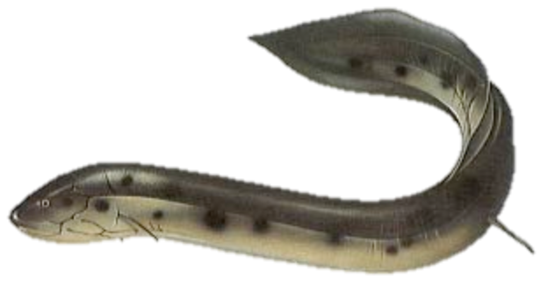


Slide 22
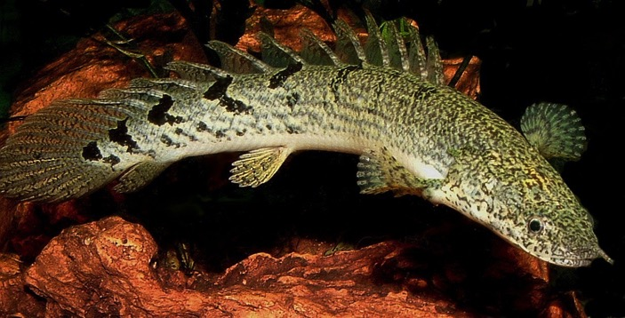
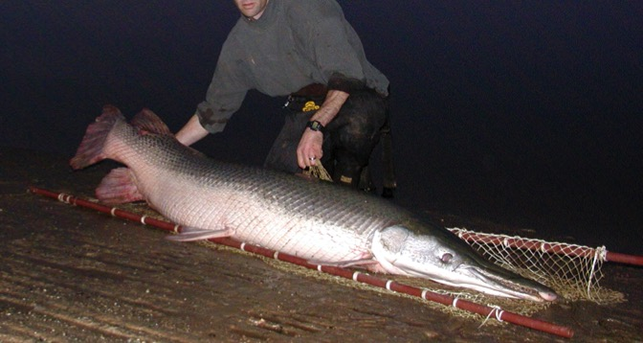
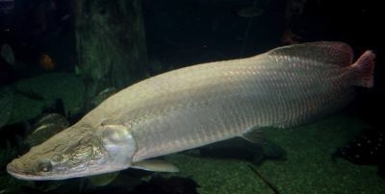
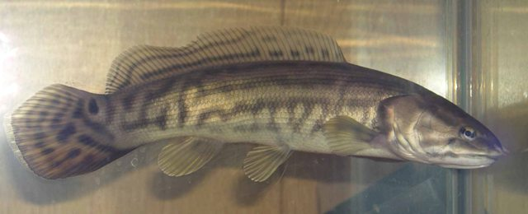
The air-breathing fishes
Air-breathing is very common among fishes
Bichir
Gar
Arapaima (a giant teleost)
Bowfin
Notes:
In fact, air breathing is common in bony fishes. We find it in both lobe-fins and ray-fins, suggesting it is a primitive feature for all bony vertebrates. In some species, it has re-evolved, in different forms.

Slide 23

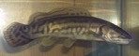

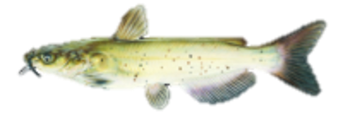
Which evolved first: the swim bladder or the lung?
SB
Lung
Lung
Lung
Neither
Lung
SB

Slide 24
Which evolved first: the swim bladder or the lung?
SB
Lung
Lung
Lung
Neither
Lung
SB
Notes:
The sequence of synapomorphies is the sequence of the evolution of a character.

Slide 25
Part I. Parsimony (Semi-formally)

Slide 26
0
0
1
1
1
Notes:
Apply the data to the corresponding tips. Proceed downward from the tips towards the root.

Slide 27
Tree traversal
An recursive algorithm that visits every tip and every node in a tree
Downpass (postorder) traversal
Proceeds from the tips towards the root
Uppass (preorder) traversal
Proceeds from the root to all of the tips.
Notes:
*A recursive algorithm is a process that proceeds in turns of itself.

Slide 28
Tree traversal
1 Begin at a node;
2 If :
3 node is a tip, return;
4 Else:
5 proceed up left descendant;
6 proceed up right descendant;
7 Return;
Notes:
Node, this algorithm is recursive. It calls itself.
Generally, we would initiate this process at the root (if we wanted to visit the whole tree). Or any arbitrary internal node, if we need a subset of the tree.
If you experiment with this, you will see that this process visits every single node in the tree.

Slide 29
Uppass (preorder)
1 Begin at a node;
2 Some F(x)
3 If :
4 node is a tip, return;
5 Else:
6 proceed up left descendant, go to 1;
7 proceed up right descendant, go to 1;
8 Return;
Notes:
Node, this algorithm is recursive. It calls itself.
Generally, we would initiate this process at the root (if we wanted to visit the whole tree). Or any arbitrary internal node, if we need a subset of the tree.
If you experiment with this, you will see that this process visits every single node in the tree.

Slide 30
Downpass (postorder)
1 Begin at a node;
2 If :
3 node is a tip, return;
4 Else:
5 proceed up left descendant, go to 1;
6 proceed up right descendant, go to 1;
7 Some F(x)
8 Return;
Notes:
Node, this algorithm is recursive. It calls itself.
Generally, we would initiate this process at the root (if we wanted to visit the whole tree). Or any arbitrary internal node, if we need a subset of the tree.
If you experiment with this, you will see that this process visits every single node in the tree.

Slide 31
2. Phylogenetic networks
Trees and traversals

Slide 32
Fitch downpass (postorder)
A
T
G
C
C
C
A
{C,G}
{A,C}
{C,G,T}
{C}
{C}
{A,C}
Notes:
Apply the data to the corresponding tips. Proceed downward from the tips towards the root.

Slide 33
Tree traversal
An recursive algorithm that visits every tip and every node in a tree
Downpass (postorder) traversal
Proceeds from the tips towards the root
Uppass (preorder) traversal
Proceeds from the root to all of the tips.
Notes:
*A recursive algorithm is a process that proceeds in turns of itself.

Slide 34
Tree traversal
1 Begin at a node;
2 If :
3 node is a tip, return;
4 Else:
5 proceed up left descendant;
6 proceed up right descendant;
7 Return;
Notes:
Node, this algorithm is recursive. It calls itself.
Generally, we would initiate this process at the root (if we wanted to visit the whole tree). Or any arbitrary internal node, if we need a subset of the tree.
If you experiment with this, you will see that this process visits every single node in the tree.

Slide 35
Uppass (preorder)
1 Begin at a node;
2 Some F(x)
3 If :
4 node is a tip, return;
5 Else:
6 proceed up left descendant, go to 1;
7 proceed up right descendant, go to 1;
8 Return;
Notes:
Node, this algorithm is recursive. It calls itself.
Generally, we would initiate this process at the root (if we wanted to visit the whole tree). Or any arbitrary internal node, if we need a subset of the tree.
If you experiment with this, you will see that this process visits every single node in the tree.

Slide 36
Downpass (postorder)
1 Begin at a node;
2 If :
3 node is a tip, return;
4 Else:
5 proceed up left descendant, go to 1;
6 proceed up right descendant, go to 1;
7 Some F(x)
8 Return;
Notes:
Node, this algorithm is recursive. It calls itself.
Generally, we would initiate this process at the root (if we wanted to visit the whole tree). Or any arbitrary internal node, if we need a subset of the tree.
If you experiment with this, you will see that this process visits every single node in the tree.

Slide 37
Tree traversal animation

Slide 38
Tree traversal animation

Slide 39
Tree traversal animation

Slide 40
Tree traversal animation

Slide 41
Tree traversals are used to…
Optimise data on a tree
Generate all tree topologies
Perform all branch-breaking and reinsertion operations
Anything else where you need to visit all nodes in a tree

Slide 42
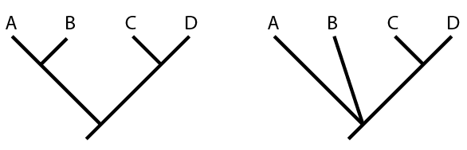
Tree encoding
((A,B),(C,D));
(A,B,(C,D));
Newick format
Text based
Hierarchical parentheses

Slide 43
Ancestor list
5
3
4
2
0
1
6
7
9
8
10
11
12
Index | 0 | 1 | 2 | 3 | 4 | 5 | 6 | 7 | 8 | 9 | 10 | 11 | 12
Anc | 10 | 9 | 7 | 8 | 7 | 12 | 9 | 8 | 11 | 10 | 11 | 12 | NA

Slide 44
Edgetable (many R packages)
PARENT | CHILD
12 | 5
12 | 11
11 | 8
8 | 3
8 | 7
7 | 4
7 | 2
11 | 10
10 | 0
10 | 9
9 | 1
9 | 6
5
3
4
2
0
1
6
7
9
8
10
11
12

Slide 45
left_desc;
right_desc;
parent;
NULL
left_desc;
right_desc;
parent;
NULL
NULL
NULL
left_desc;
right_desc;
parent;
NULL
left_desc;
right_desc;
parent;
NULL
left_desc;
right_desc;
parent;
NULL
Notes:
Trees as ‘pointers and records’

